Slide 1
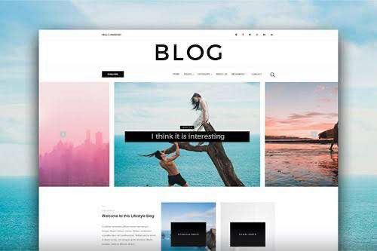
BLOG APPLICATION
SOFTWARE REQUIREMENTS SPECIFICATION
TEAM MEMBERS ( B.TECH IT )
Aaliya Begam B
Kamesh V
Meenakshi M T
Nandhini A

Slide 2
INTRODUCTION
“Web Application” using HTML,CSS, and JavaScript.
A blog, short for weblog, is a frequently updated web page used for personal commentary or business content.
Blogs are often interactive and include sections at the bottom of individual blog posts where readers can leave comments.
Blog posts can be categorized into topics or categories, and users can add tags to help organize and classify content.
.

Slide 3
INTRODUCTION
The goal of a blog is to publish information on your website that assists potential consumers in learning more about your product or service and provides them with answers to their queries.
It can be used to share information and opinions to an online community.
Blogs are often used to share information, insights, and knowledge on specific topics. They can be educational resources for readers interested in learning about various subjects.

Slide 4
SOFTWARE REQUIREMENTS
PROGRAMMING LANGUAGES
BROWSER SUPPORT
FRONTEND | HTML, CSS, JavaScrpit
Google chrome
Microsoft edge
Mozilla Firefox
Safari

Slide 5
HARDWARE REQUIREMENTS
Device : Any device that can run a modern web browser.
Processor(CPU) : Basic single-core or multi-core processor.
Memory(RAM) : Minimum 2GB, more for better performance.
Storage : As low as 16GB is sufficient for running web apps.
Graphics : Integrated graphics or basic Graphics Processor Unit (GPU)
Network : Internet connectivity is required.
Operating system : Compatible with your browser of choice.
Input devices : Keyboard and mouse (or touchscreen for mobile devices.

Slide 6
FUNCTIONAL REQUIREMENTS
User Registration and Authentication:
Users should be able to register an account with a valid email address.
Search and Navigation:
Users should be able to search for blog posts based on keywords, tags, or categories.
Posts should be organized into an archive, and users can navigate by date.
Responsive Design:
The blog application should be accessible and functional on various devices (desktop, mobile, tablet).
User Profile and Management:
Users should have profile pages with their bio and links to their posts.

Slide 7
NON - FUNCTIONAL REQUIREMENTS
Performance:
The blog should load quickly, with a minimal response time.
It should handle a large number of concurrent users without performance degradation.
Security:
User data, including passwords, should be securely stored and transmitted.
Protection against common web vulnerabilities (e.g., SQL injection, cross-site scripting) should be in place.
Scalability:
The system should be able to scale to accommodate a growing number of users and posts.

Slide 8
Thank you … !

